Slide 1

Predicting Customer Bookings
British Airways

Slide 2
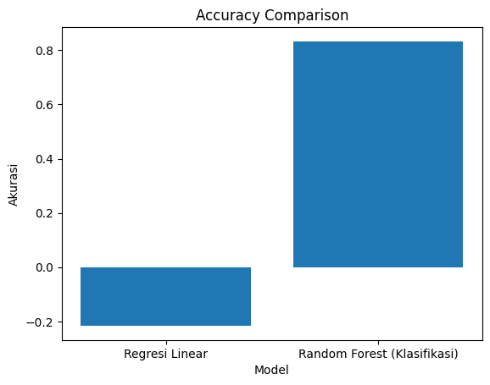
Predicting Customer Bookings
Compare 2 models, linear regression and random forest.
It can be seen that random forest is a fairly good model in this case

